Slide 1

“gyan”
ERICSSON CHARGING SYSTEM OVERVIEW
BUSS Portfolio & Offerings
A Technical Learning initiative of BUSS DU CoE CB&M DC Chennai

Slide 2
agenda
ERICSSON CHARGING SYSTEM
CHARGING SYSTEM ARCHITECTURE
SAMPLE USE CASE FLOWS
CHARGING SYSTEM EVOLUTION
ERICSSON CATALOGUE MANAGER

Slide 3
Ericsson charging system pre-integrated ocs for true end-2-end
CUSTOMER INTERACTION
Product and order management
CHARGING
CUSTOMER EXPERIENCE
POLICY
Service Enablement
OCS
PCRF
ENFORCEMENT
NETWORK
2G LTE Fixed 3G WI-FI
PCEF
Notes:
Talking 3GPP language, Charging System 6 is the OCS (Online Charging System). As you will see Charging System 6 has extremely rich functionality built-in for rating, packaging, bundling and end-user communication. The requirements from the consumers and the enterprises to have control of consumption, to be able to personalize services with the right quality and at the same time shorten time-to-market for new services while reducing cost will require an end-2-end solution approach. OCS integrated both southbound towards the traffic management and Core/Radio but also northbound towards self-care, customer care and so on. Operators that invest in an end-to-end solution to be able to control the service quality for individual users, specific service or devices will sit in the center of the value chain providing clear value.
So what is the end-2-end solution we are talking about?
To explain it we have categorized the operator environment into 4 functional layers; Customer Interaction, Charging, Policy and Enforcement.
All these 4 layers will need to be in place in an operator network to be able to offer personalized services fully.
Integration of Policy (PCRF) and Charging (OCS) is happening all over the world and the solution provides substantially shortened TTM for operator launching new services since the service creation is simplified.
The Policy and Charging will need to be integrated also with the Enforcement (PCEF) function in the core network to secure the right service to be delivered to the right user with the right quality.
Customer Interaction is about using all the valuable information available in the above 3 layers can add. A lot of value such as consumer spending control, flexible service choices and a better user experience. All presented to the end-user in real-time and on the preferred user interface/device.
The end-2-end solution will secure telecom operators capabilities in monetization, personalization and user experience and establish them as attractive partners to application providers, OTT players and media companies. With Ericsson Charging System these pre-integrations to Ericsson PCRF (SAPC) and Customer Interaction with Ericsson Service Enablement Platform are already in place making the effort to create true end-2-end much easier.

Slide 4
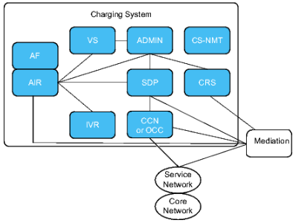
Charging System ARCHITECTURE
Notes:
Reference: 1/1551-FAV 101 72/4

Slide 5
SDP
The SDP network element contains the database with subscribers and account information.
Example functionality in SDP:
Provides rating of calls, events, and sessions.
Provides policy decisions
Post processing of Charging Data Records (CDRs)
Initiation of Unstructured Supplementary Service Data (USSD) notifications and SMS notifications
Maintains subscription life cycle
Notes:
Reference: 1/1551-FAV 101 72/4

Slide 6
Account Information and Refill System (AIR)
The AIR server handles messages from both traffic and administrative network elements, inside Charging System.
Examples of functionality in AIR:
Contains the function groups refill function, adjustment function, and the enquiry and update function
Handles account information in the form of enquiries and account administration
Supports a number of file-based batch jobs for making bulk adjustments, promotions, and refills
AIR can handle multiple Voucher Servers (VSs).
Notes:
Reference: 3GPP TS 32.240 V12.6.0 (2014-12)

Slide 7
Account Finder (AF)
AF is a network element that provides SDP information for subscriber accounts in the system.
AF enables the centralized management of multiple SDPs.
AF is always collocated with AIR.
Notes:
Reference : 1/1551-FAV 101 72/4

Slide 8
Charging Control Node (CCN)
CCN is responsible for protocol translation, session control, and coordination with other network elements. To perform this task, CCN supports a number of protocols, both towards the MSC and towards the different network elements.
Examples of more functionality in CCN:
Creates CDRs for handled charging sessions
Terminates the DCCA for Charging System
Contains service logic for the Diameter service charging application to support content-based services
Contains proxy logic and acts as a proxy agent for policy management.
Relay of Online Charging of GPRS and SMS using CAPv3
Relay of Voice Charging Control using Capability Set 1 with Ericsson Extensions (CS1+), USSD Callback, CAPv1, and CAPv2.
Relay of Online Charging of GPRS and SMS using CAPv3
Notes:
Reference: 1/1551-FAV 101 72/4

Slide 9
Online Charging Control (OCC)
OCC is responsible for protocol translation, session control, and coordination with other network elements. To perform this task, OCC supports a number of protocols, both towards the core network and towards the different network elements.
Examples of more functionality in OCC:
Creates CDRs for handled charging sessions
Terminates the Diameter Credit Control Application (DCCA) for Charging System
Contains service logic for the Diameter service charging application to support content-based services
Contains proxy logic and acts as a proxy agent for policy management
Contains service logic for integration with Multimedia Telephony Application Server (MTAS) to support multimedia telephony services.
Notes:
Reference: 1/1551-FAV 101 72/4

Slide 10
Voice Extensible Markup Language Interactive Voice Response System (VXML-IVR)
The subscriber can use IVR to change and inquire about account information, for example, refills and account balance enquiries.
IVR can be used for contacting customer care.
IVR can be used to query Bill cycle information, offers.
IVR can be used for transferring the call to another IVR (third party IVR)
Notes:
Reference 1: 1/1551-FAV 101 72/4
Reference 2: 511/1551-FAM 901 328/1

Slide 11
Voucher Server (VS)
VS is responsible for the administration and storage of vouchers.
Voucher generation
Import, and load, of voucher batches
Purging of vouchers
State changes on vouchers
Enquiries of voucher information
VS supports geographic redundancy by data replication between two distant sites in case of disaster or system maintenance.
Notes:
Reference 1: 1/1551-FAV 101 72/4
Reference 2: 1/1551-FAM 901 478

Slide 12
Mobile IN Service Administration Tool (MINSAT)
MINSAT is only supported for upgrading customers.
MINSAT handles subscriber administration for Charging System. No traffic is handled, but interaction in real time with other systems for provisioning and updates are possible through GUI and through the external interfaces provided.
MINSAT has support for geographic redundancy.
Notes:
Reference : 1/1551-FAV 101 72/4

Slide 13
Ericsson Customer Management System (ECMS)
ECMS is one of two administrative systems (ADMIN) existing for Charging System.
Subscriber Provisioning (create subscriber, delete subscriber, HLR installation)
Subscription Management (refill, subscriber usage, voucher query).
ECMS supports geographic redundancy by data replication between two distant sites in case of disaster or system maintenance. Besides data synchronization, health monitoring is included.
Notes:
Reference 1: 1/1551-FAV 101 72/4
Reference 2: 1/1551-FAM 901 485

Slide 14
Charging data Reporting System (CRS)
CRS is a system for correlating information from many different sources to reconcile provisioning and use information, and provides information for customer enquiries in near real time.
CRS collects data from various network sources, then filters, correlates, and transforms this information to provide business critical reports for customer care, financial, and audit departments.
CRS supports geographic redundancy by data replication between two distant sites in case of disaster or system maintenance.
Notes:
Reference : 1/1551-FAV 101 72/4

Slide 15
Charging System - Network Management Toolkit (CS-NMT)
CS-NMT, hosting application System Upgrade Framework, is a central toolbox that performs software upgrades and updates for the different nodes in the Charging System. For example, SDP, AIR, AF, VS, VXML-IVR, MINSAT, and CCN.
Notes:
Reference : 1/1551-FAV 101 72/4

Slide 16
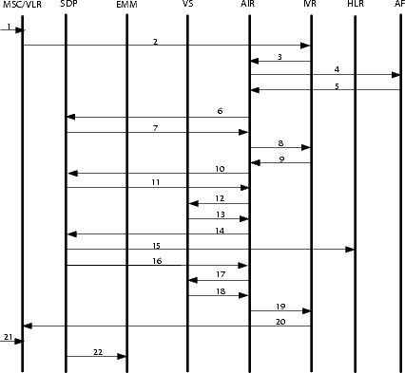
Refill through IVR
Notes:
The refill call is initiated by the Charging System subscriber.
The call is routed to the IVR. The IVR checks if the calling party number is complete.
The IVR requests account information from AIR.
AIR interrogates the Account Finder (AF) to get the SDP IP-address.
The AF returns the SDP-IP address.
AIR uses the returned SDP-IP address to requests account and subscriber data information from the SDP .
The SDP checks if any account updates are necessary and sends the result of the account information requests back to AIR.
AIR sends the requested information to the IVR, for example preferred language. The IVR plays a standard welcome announcement and a menu announcement. The subscriber selects the menu option "Voucher Refill" and enters the voucher activation number.
The entered activation code and the mobile number of the subscriber is sent to AIR for verification.
AIR requests account information from the SDP.
11.The SDP sends the result of the account information request back to AIR. AIR verifies that the subscriber exists and is not barred from refill.
12.AIR sends the entered voucher activation code to the Voucher Server for verification.
13.When the Voucher Server is finished with the verification, it will return a response to AIR.
AIR will receive a response from the Voucher Server indicating if the verification was successful or not. If it was successful, AIR sends a refill request to the SDP.
The account is increased in the SDP database. If CDR processing is used and has caused an SMS/GPRS barring, unbarring of SMS and GPRS in the HLR is supported when a certain account threshold has been reached. In this case through a refill.
The SDP sends the result of the refill back to AIR.
If the refill was successful, AIR requests the Voucher Server to set the voucher in used state.
The Voucher Server responds with the result back to AIR.
AIR sends a response to the IVR including the Account Balance and an indication if the refill was successful or not. A Data Record including the refill data is generated and sent to Ericsson MM before the response is sent to the IVR.
The IVR will use the voice prompt to notify the subscriber of the result.
The subscriber releases the call.
A CDR is sent to the Ericsson MM as a receipt (optional).
Note: The Ericsson MM module used in this traffic case is the File and Event mediation module.
Eridoc: IRN-13:000194

Slide 17
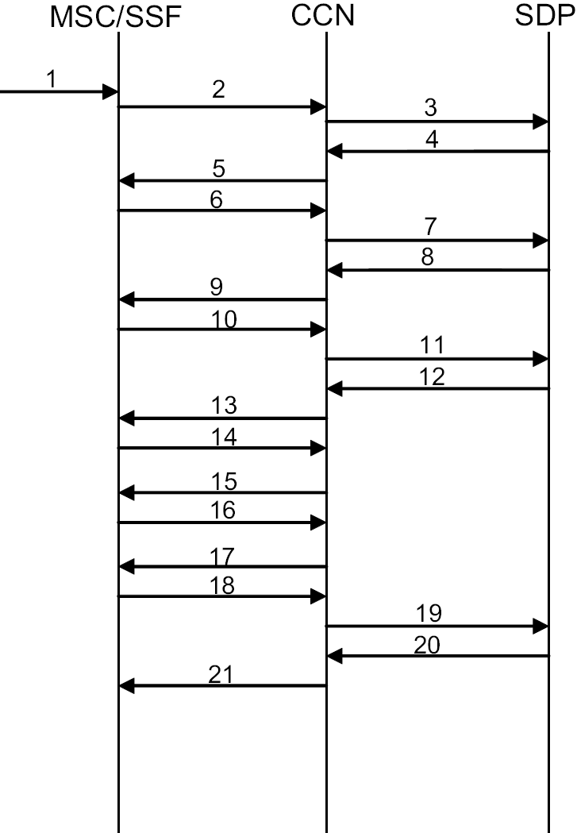
Originating Charged Call with CAPv2
Notes:
A call is initiated from a charging system subscriber. The Originating IN Category Key (OICK) of the subscriber in the VLR, routes the call to the SSF.
The SSF collects data about the call and triggers the CCN.
The CCN performs a SDP selection and sends the data, collected in step 2, in a First Interrogation to the SDP. Optionally, the CCN performs an MNP lookup or an LBC lookup, or both, at this stage.
The SDP reserves money from the account and sends the calculated call time to the CCN, together with other call data such as announcements to be played.
The CCN tells the SSF to play announcements if this has been requested by the SDP. Further on, the CCN tells the SSF to setup the call and to supervise it based on the call time calculated by the SDP.
The call lasts longer than the call time sent to the SSF, so a notification is sent to the CCN.
The CCN request the SDP to make another reservation from the account with an intermediate interrogation.
The SDP makes a new charging analysis and deducts the amount previously reserved from the account. In this example it is assumed that there is still sufficient funds left on the subscriber's account. The SDP then reserves money for the next period and forwards a new call time to the CCN.
9. The CCN passes the new call time on to the SSF.
Note:
Step 6-9 can be repeated several times. In this example, steps 10-
17 describes what happens when the subscriber's account
balance reaches the account empty limit.
The call lasts longer than the call time sent to the SSF and a notification is sent to the CCN.
The CCN request the SDP to make another reservation from the account with an intermediate interrogation.
The SDP makes a new charging analysis and updates the account. The charging analysis shows that there is not enough money on the account to cover the requested period. The SDP sends the calculated call time to the CCN together with an indication that there is no money left on the account and that a call cutoff warning announcement is to be played. The time between the warning announcement and call cutoff can be configured. For this example 30 seconds is used.
The CCN uses the 30 seconds indication from the SDP and the time between call cutoff warning and call cutoff is excluded from the new call time. The CCN then passes the new call time on to the SSF.
The SSF notifies the CCN that the time sent down in step 13 has expired.
The CCN sends the remaining 30 seconds and tells the SSF to play the call cutoff warning announcement.
The SSF notifies the CCN that the final 30 seconds has expired.
The CCN tells the SSF to play the call cutoff announcement and to disconnect the call.
The SSF notifies the CCN of the call disconnection.
A final report is sent from the CCN to the SDP. The SDP performs final charging of the call.
The SDP rates the total call and sends a final report result to the CCN.
The CCN sends a call release to the SSF.

Slide 18
Tech. Product Charging System Architecture, Charging Compound 1.8
¤ When you see this symbol, please see notes.
DNS update
to AF
SOI
UAH (XML/http)
DNS update
to AF
Ericsson CMS and MINSAT are mutually exclusive
Tech. Product Charging System
Core Network
CC API (CAI)
UAH (XML/http)
ISUP
Input and output files for batch jobs
Ericsson CMS
0..1
0..n
0..1
Input and output files for batch jobs
*SAPC/
PCRF
GGSN-MPG
MINSAT
o
0..n
VSIP
(XML/http)
VS
VXML IVR
0..n
Batch jobs (ftp)
0..1
Gx, Gy
Gx, Gy
0..n
AIR-IP (XML/http)
SASN
Gy- rel
10
VSP
(XML/http)
VSIP
Gy/DCCA
AIR-IP (XML/http)
RPC
AIR-IP (XML/http)
0..n
SGSN
Esy Sy
0..10
VSP XML/http
Same platform (FDS/Sun)
Co-locatable
gprsSSF
OCC
AIR
DQ
Thresh. Notif.
(ftp)
Batch jobs (ftp)
2..n
R
0..n
CIP-IP
CAI
CS-NMT
1..n
CAPv3
(DCIP)
SDP data
notif
(xml/ftp)
Batch jobs (ftp)
MSC
Back-end i/f
UCIP
gsmSSF
gsmSRF SSF / SRF
RPC
ACIP
CCN
DQ
SDP
CS1+, CAPv1-v3
2..n
NQ
1..n
R
LDAP towards ext. system
(Community)
CS1+
0..n
ERTC
CIP-IP
MML
(lifecycle notifications)
DQ
AF
Batch jobs (ftp)
SCAP,
SCAPv2/
DCCA
gsmSCF SCF
Esy
Sy
DNS update
from ADM
o
Ro
Disc
Notif
(JSON)
SDP Account
Snapshot
R
Ericsson Rule Engine
SCAP,
SCAPv2/
DCCA
DQ
Ericsson Internal Interface
IMS Common Nodes
SCAPv2/
DCCA
Recovery and
Synchronization (ftp)
Open Interface
CCC
RMA
R
SDP data
notif
(xml/ftp)
UAH (XML/http)
EMAPv1&2,
ETSI MAP
R
Interface towards nodes
containing ERE
MRF-C
S-CSCF
MAP v3 (prop)
DQ
DNS Query
to Account Finder
MTAS
MGC
E-CSCF
CAI (barring)
CRS
Snapshot
Multi Mediation
MML (barring)
CRS
CDR (ftp)
DCCA,
DBP(A), Radius
CAI3G
0..n
Number Query to FNR
and HLR
N-SBG
P-CSCF
Online Mediation (On-line Gateway)
File & Event Mediation
CRS
Data
Import
NQ
0..n
R
0..n
R
Charging Compound Nodes
0..1
ZELS
Service Network
Service Provider
Support Function
CAI
EMAP v1&v2,
ETSI MAP
CC/HLR Data
Change (ftp)
Certified Nodes
INS
Same bundle
DQ
NQ
VPN
1..n
Verified Nodes
Content Delivery
Support Function
DCCA, DBP(A),
Parlay (Corba),
Parlay X, Radius
+ other
EMA
HLR/HSS
0..n
0..n
MML
EAB/K-11:1529 Uen, Rev PA8
0..n
FNR
NQ
Nodes still supported – not available for new sales
SMS-C
CAI3G
SMPP
Discount
Admin (xml/RPC)
DTE
New since previous version
*Esy when SAPC used, Sy for other PCRF
Notes:
Tech. Product Charging System Architecture Tech. Product Charging System Architecture
9/24/20232011-12-05
EAB/K-11:1529 Uen, Rev PA5 EAB/K-11:1529 Uen, Rev PA4
18
Tech. Product Charging System Architecture
2011-12-05
EAB/K-11:1529 Uen, Rev PA4
18
RESPONSIBLE FOR ARCHITECTURE FOR CHARGING SYSTEM 5.0.2 is epkmab
Clarifications:
OCC Back-end i/f, protocol specification called Data Traffic Rating Charging Context
AS=Analytic Suite
DTE=Dynamic Tariffing Engine
CS-NMT for upgrading of VXML-IVR, CCN, SDP, MINSAT, VS and AIR
SOI (Service Oriented Infrastructure) is the integration interface towards Ericsson Customer Management System. See Ericsson Customer Management System CPI and Support Manual for more information. DTE (Dynamic Tariff Engine) is a 3rd party product (from Rorotika). DTE is used in the business solution Dynamic Discount Solution (DSS). The communication path is:
DTE -> EMA -> SDP (through the Discount administration interface (xml/RPC))
HP-IVR is not supported any longer.
CAP v3 (MSC-CCN) for CS SMS
CAP v3 (SGSN-CCN) for PS SMS, GPRS
SMPP (SDP-Service Network) is connected towards SMS-C.
Query (ATI) from CCN to HLR is used for fetching A&B-subscribers location (standard MAP v2).
Query (ATI) from ChSys IN to HLR is used for fetching B-subscribers location (standard MAP v2).
NQ (ATI) for Mobile Number Portability from CCN, ChSys-IN to FNR, NPLR uses either MAPV3 with Ericsson proprietary extensions or standard MAP v3 .
MAP v3 (SLR) between CCN and ZELS uses Ericsson proprietary extensions.
The Account Finder is to be seen by the clients as one logical node even that it might be distributed on several servers.
If the Account Finder is present it is always co-located with AIR. One AIR—server may contain zero or one AF
Only IMS Common Nodes that generate charging data is included in this slide. For more detailed information regarding IMS nodes that generates charging data, please refer to the IMS product plans.
For IMS the Online Mediation is called Event Collector and is stripped of functionality. All backend possibilities except for ”Intercon BE” have been removed. This is done by means of licensing.
Internal interfaces for migration from 3rd party vendors are not shown. These interfaces are normally only available for Ericsson personnel providing the Migration Service.
Commands (barring and provisioning) from MINSAT towards HLR are always sent through Ericsson Multi Activation.
BUGS adaptation needed on Multi Mediation/Online Mediation, Multi Mediation/File & Event Mediation and Ericsson Multi Activation.
Call and account history require CRS and Multi Mediation/File & Event Mediation.
VS Geographical redundancy is available.
SDP Geographical redundancy is available.
MINSAT Geographical redundancy is available

Slide 19

Charging System evolution
Account Based Rating and Charging
Offer Based Product Creation
Catalog Enabled Product Handling
GROWTH
Real time
Charging
PERSONALIZATION
- Many services (Voice, data, content/OTT..)
- Many networks (LTE, WiFi, IMS..)
NETWORKED SOCIETY
Shorter TTM
Efficiency in scale
Notes:
An example of this is how the system has transformed over time, let me describe the developments of the rating function from the initial Account Based Rating and Charging. In earlier versions where the ambition of operators was to manage a huge increase of the number of users. The user account was in the center.
In a second stage, where most customers are today, the requirements for Personalization and Packaging of services are much clearer. Many services, from many networks and accesses is the reality. The need to move the focus from account to offer became evident. Offers were created and consumers and enterprises could chose from many different offerings. We call that Offer based Product Creation.
The need for more and more offerings and more and more flexibility is now pushing the operators towards Catalog Enabled Product handling which in short means a modularization of offerings that flexibly can be orchestrated from a integrated Product Catalog. This we achieve is Charging System 6 with pre-integration to our Product Catalog. We believe this development will accelerate on the market and to maintain short TTM operators will need to walk this way.

Slide 20
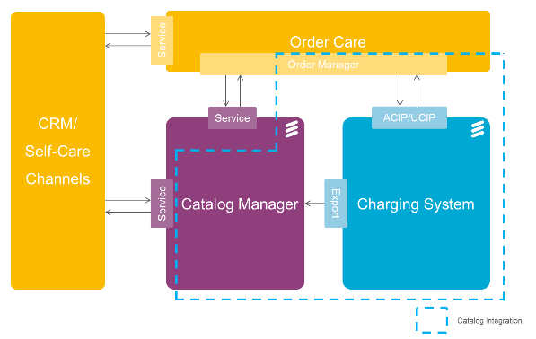
ERICSSON CATALOG MANAGER INTEGRATION
Notes:
Reference: 221 09-FGC 101 2700

Slide 21
Ericsson Catalog Manager (ECM)
ECM is a catalog management system that allows an operator to create and manage business data. This means, for example, to define, introduce, manage, and retire product offerings.
ECM contains a module that is adapted to interpret data received from Charging System.
Notes:
Reference: 221 09-FGC 101 2700

Slide 22
Ericsson Order Care (EOC) and Ericsson Order Management (EOM)
EOC and EOM handle the provisioning of POs and enable them for sales. EOM is adapted to the Account administration Communication Integration Protocol (ACIP) and the User Communication Integration Protocol (UCIP) and is only partly used in the catalog integration.
Notes:
Reference: 221 09-FGC 101 2700

Slide 23
Ericsson Charging System
Charging System provides rule based charging and policy. GUI tools are used to build rating rules, charging rules, account balance structures, discount rules, and so on.
The following Charging System network elements are included in the catalog integration:
Service Data Point (SDP) In SDP the templates called CFS charging capabilities are configured. The CFS charging capabilities are exported from SDP to ECM over the internal SDP Data Notification interface.
Account Information and Refill (AIR) EOC provisions subscriber data to AIR over the ACIP and UCIP interfaces. The information is then passed on to SDP.
Notes:
Reference: 221 09-FGC 101 2700

Slide 24


Personalized services
speed
speed
50 MBit
100 MBit
0
50
100
100101 011001 110100
0
50
100
100101 011001 110100
10010 11100
10010 11100
1001
1001
Volume
Volume
60 GB
75 GB
0
50
Unlimited
0
50
Unlimited
Throttle
Throttle
YES
NO
Voice
Voice
2000 Min
Unlimited
0
2500
Unlimited
0
2500
Unlimited
Messages
Messages
500 SMS
Unlimited
0
2000
Unlimited
0
2000
Unlimited
Social
€ 1 / day
Purchase
Social
OFF
€ 5 / day
Purchase
OFF
Movies
€ 30 / Month
Purchase
Movies
ON
€ 60 / Month
Purchase
OFF
Notes:
Personalization is the ability for a customer (consumer or enterprise) to adjust the service and the service content to fit with their actual needs. An operator can package and target specific needs but Personalization lets the customer do the job. For example in a Self-Care environment. The operator can only enable the user the ultimate freedom. That freedom is achieved with Charging System and our pre-integrated Self-Care.
This picture is taking personalization rather far, but this is possible already today, in Charging System!

Slide 25
references
Reference 1: System Description, 1/1551-FAV 101 72/4
Reference 2: CS Commercial presentation, 221 09-FGC 101 2700
Reference 3: technical Product, EAB/K-11:1529

Slide 26


